Slide 1

Vegan Tourism: NYC vs Toronto

Slide 2

Vegan Tourists need more vegan friendly destinations
While travelling abroad, it is very difficult to find places that are vegan/vegetarian friendly and searching them up takes time and effort.
As the owner of a fictional travelling agency, my clients need to decide between NYC and Toronto, and the deciding factor for them is vegan/vegetarian friendliness.
I would therefore need to figure out which city has more vegan/vegetarian restaurants.

Slide 3
Data Acquisition
Neighborhood datasets for Neighborhood data and coordinates obtained through web scraping and data parsing.
Venue Data Obtained through running the Neighborhood datasets through Foursquare Places API for venue data.
City coordinates obtained using Google Maps API’s Geocoder package.
Maps generated using folium and filtered venue data.

Slide 4
Data Cleansing: Neighborhood Data
Obtaining the Neighborhood datasets for each city required different approaches, due to differing sources and formats.
NYC data required parsing raw JSON files into pandas data frame that we created using specific column names.
Toronto data required scraping the Wikipedia page for Toronto postal codes as well as parsing the dataset given to us to obtain two separate datasets, which then required merging based on common feature, postal code.
Resulting data frames each contain 4 common features:
Borough
Neighborhood
Latitude
Longitude
Toronto data frame contains extra feature of postal code.

Slide 5
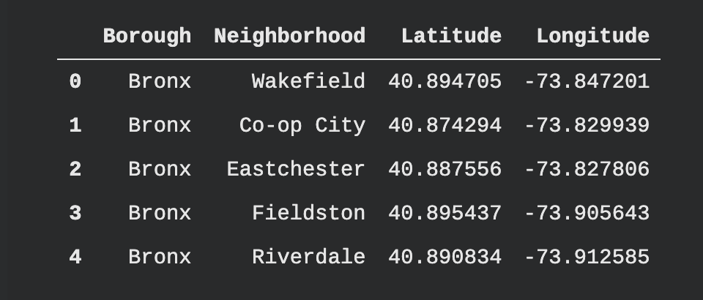
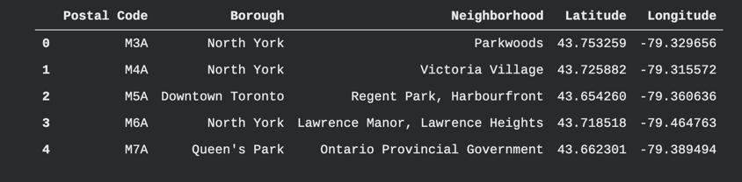
Data Cleansing: Neighborhood Data
Snapshots of each data frame. Note the Postal Code feature in the Toronto Neighborhood Data. Each data frame contains the 4 common features, which we will need later on.
New York City Neighborhood Data
Toronto Neighborhood Data

Slide 6
Data Cleansing: Venue Data
After grabbing the Neighborhood data, we need to run the Neighborhood through the Foursquare API to obtain venue data for each neighborhood.
After running the proper credentials, we need to run a function given to us in the previous lab to give us us all the nearby venues.
This will result in 2 data frames, containing venues for each city
This needs to be filtered for only the vegan/vegetarian restaurants in each city.

Slide 7
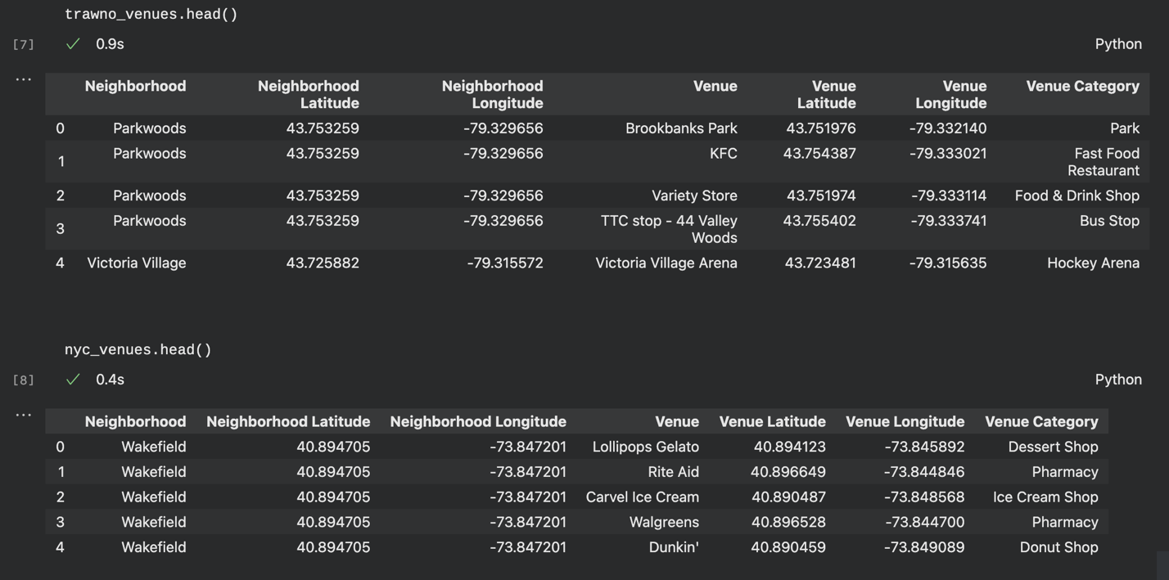
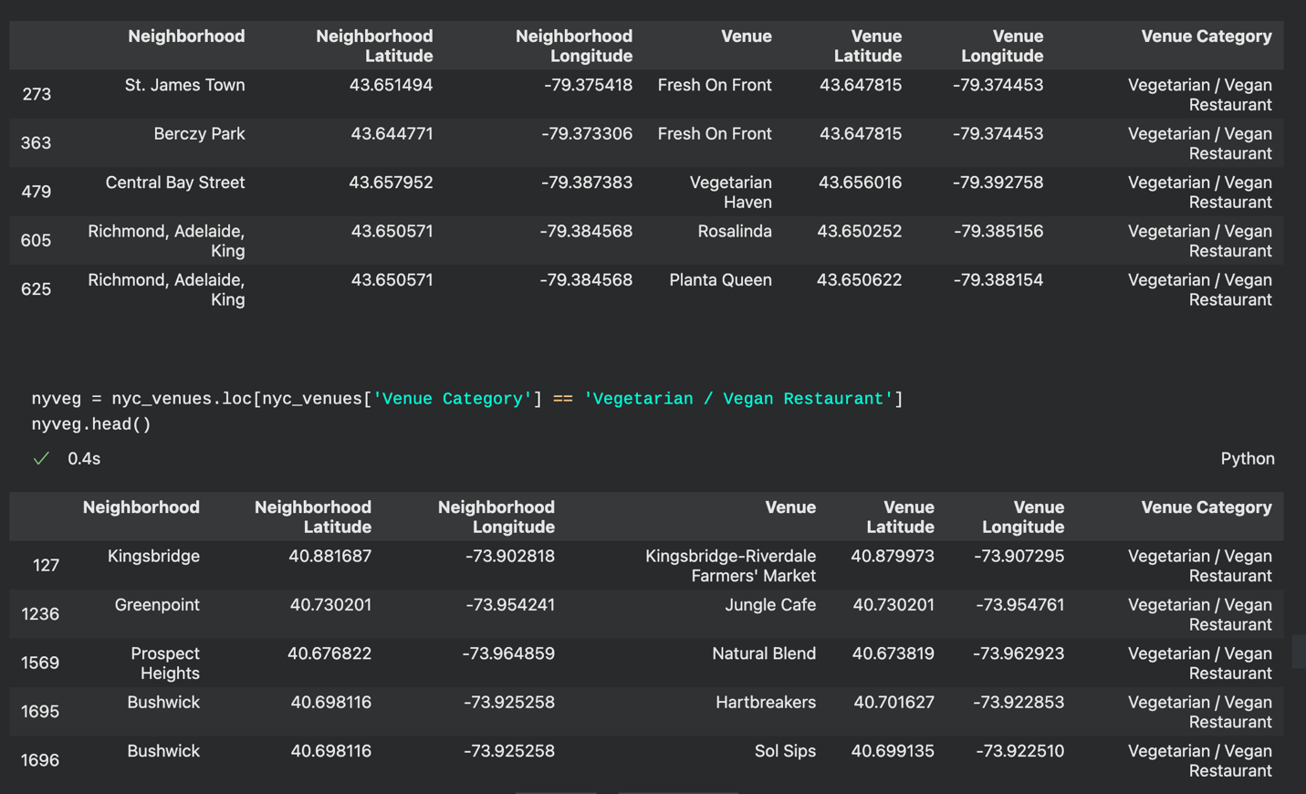
Data Cleansing: Venue Data
Venue dataset pre filtering
Venue Dataset Post filtering for ‘Vegetarian / Vegan Restaurant”
Note: Some places might be chains, and would therefore have multiple locations, and as a result should not be marked as duplicates.

Slide 8
Data Cleansing: City Coordinates and Map Generation
After filtering the venue data for vegan/vegetarian restaurants, we need to obtain the city coordinates for each city, and generate base maps for each city using those coordinates
This involved using the Geocoder package to obtain the coordinates then using folium to map the cities as well as mark the places of interest.

Slide 9
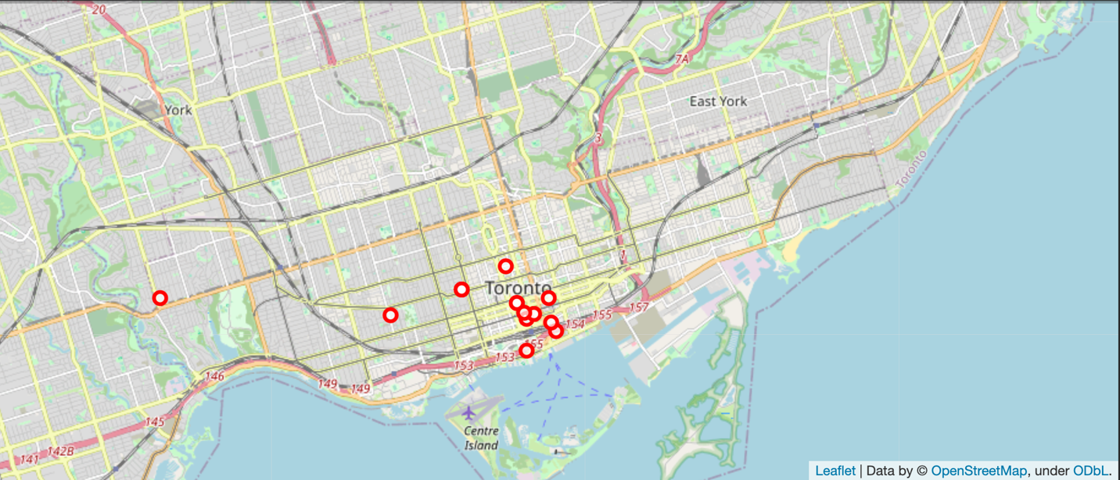
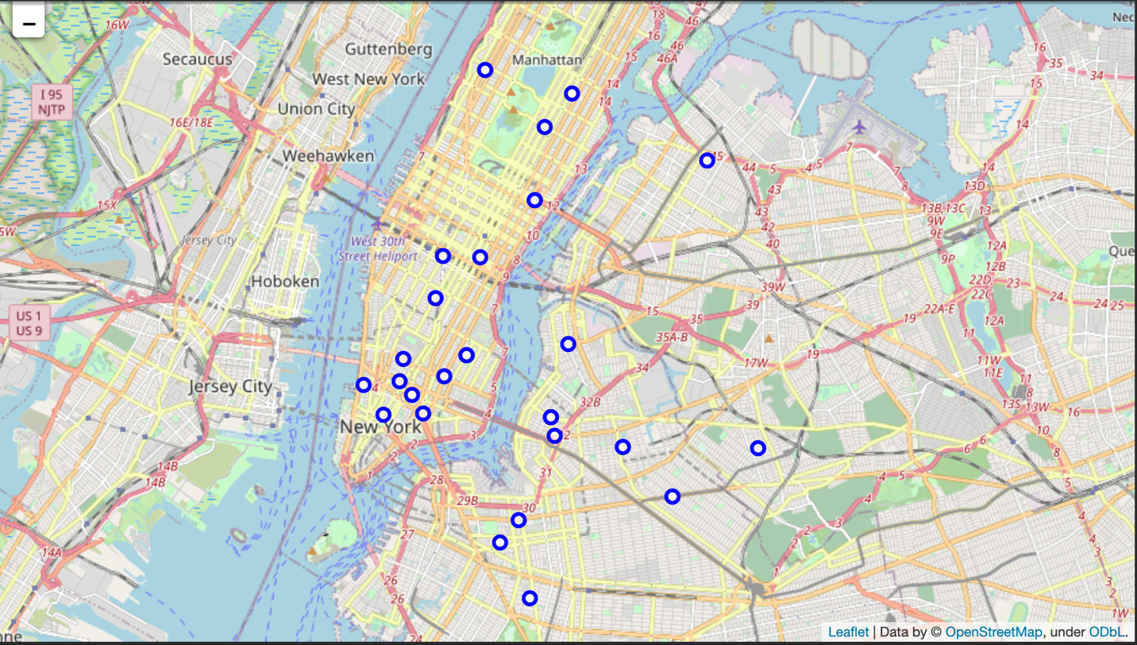
Data Cleansing: City Coordinates and Map Generation
Map of Toronto
Map of New York City
New York City clearly has more options for vegan tourists, and there is a good spread, so it will give people the incentive to explore the city more knowing that they have food options wherever they are travelling to.

Slide 10
Results/ Conclusion
Based on the sheer number of vegetarian options I can conclude that NYC is very, very vegan friendly. I can confidently recommend New York City as the better option for my clients to travel to for the future and can use this approach to evaluate other cities for vegan friendliness and travel viability.

Slide 11
Future Thoughts
I only focused on purely vegan/vegetarian restaurants and didn’t include restaurants which might have vegan/vegetarian options in addition to their non-vegetarian options. As a result, I might have eliminated some viable options for my clients.
I could also adjust the approach to check for restaurants that match the customers preferred cuisine and/or create food-based tours where the focus is travelling and sampling famous local joints and eateries, thus making my package options very diverse, while offering a special theme that other places might not have.

